Slide 1
North Hills Soccer Club
Director of Coaching Program Proposal

Slide 2
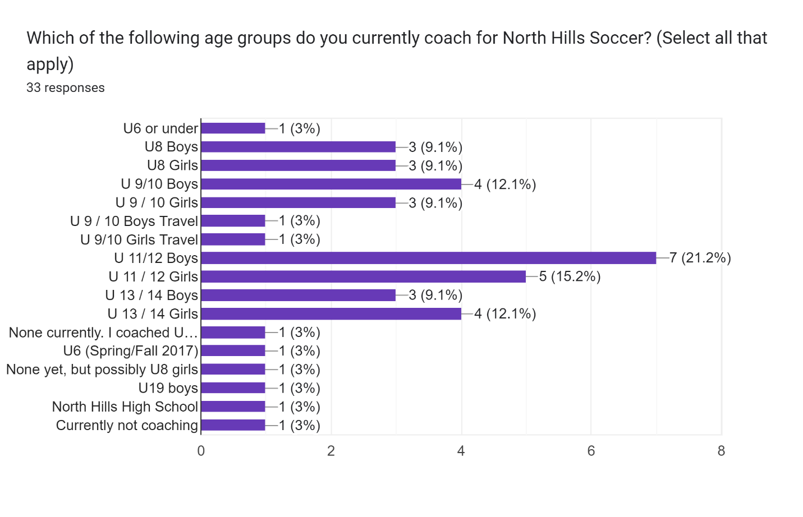

Slide 3
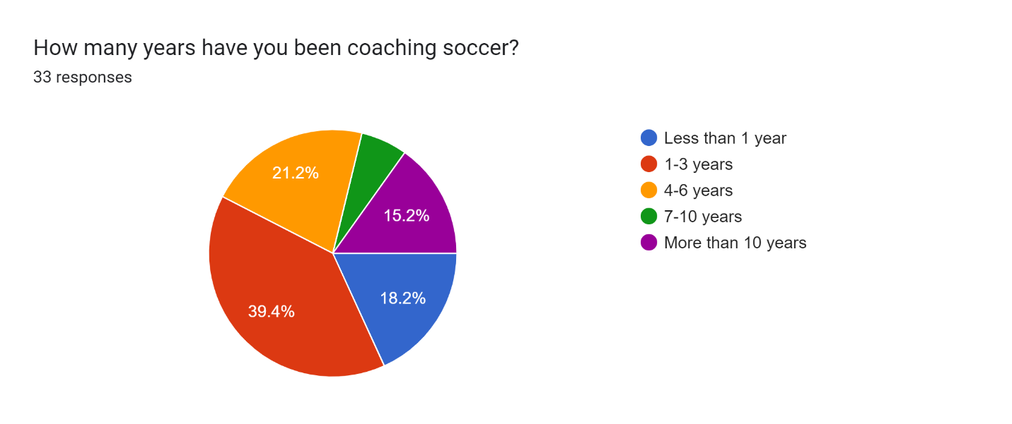

Slide 4
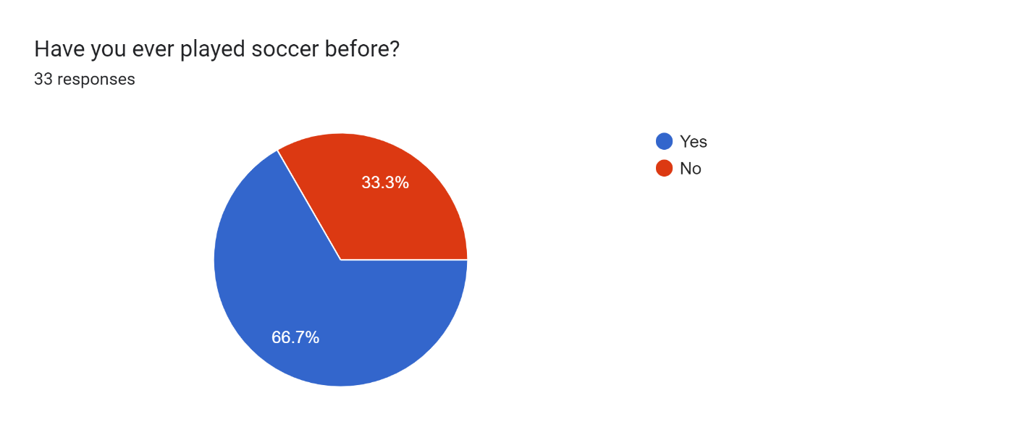

Slide 5
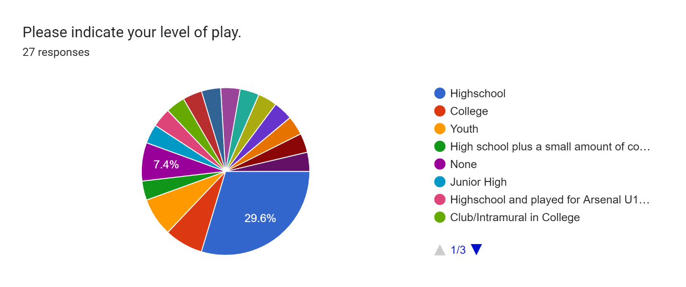

Slide 6
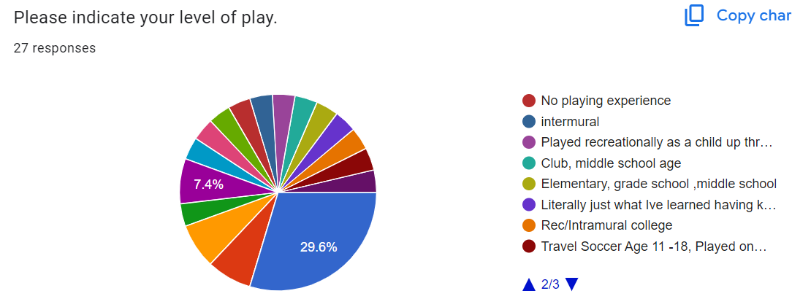

Slide 7
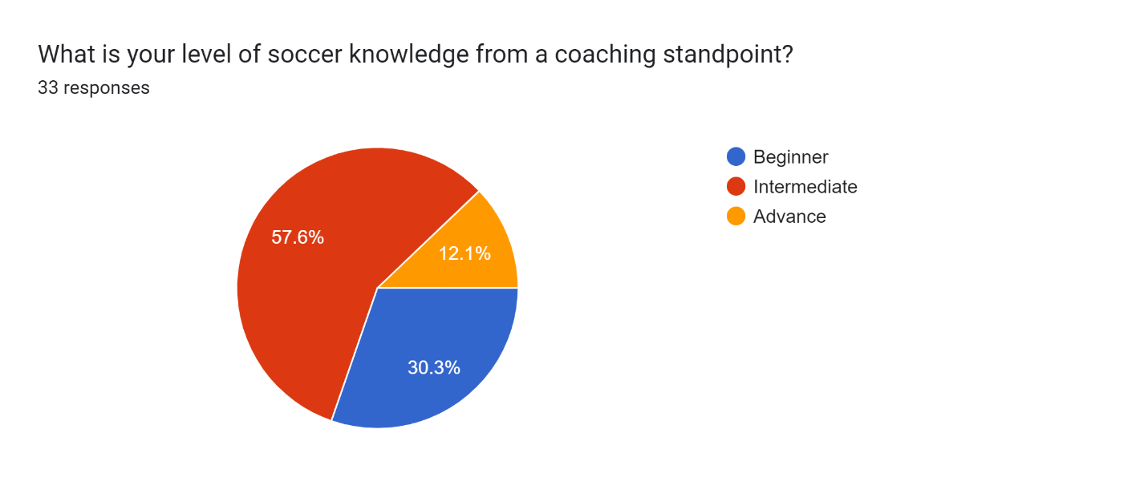

Slide 8
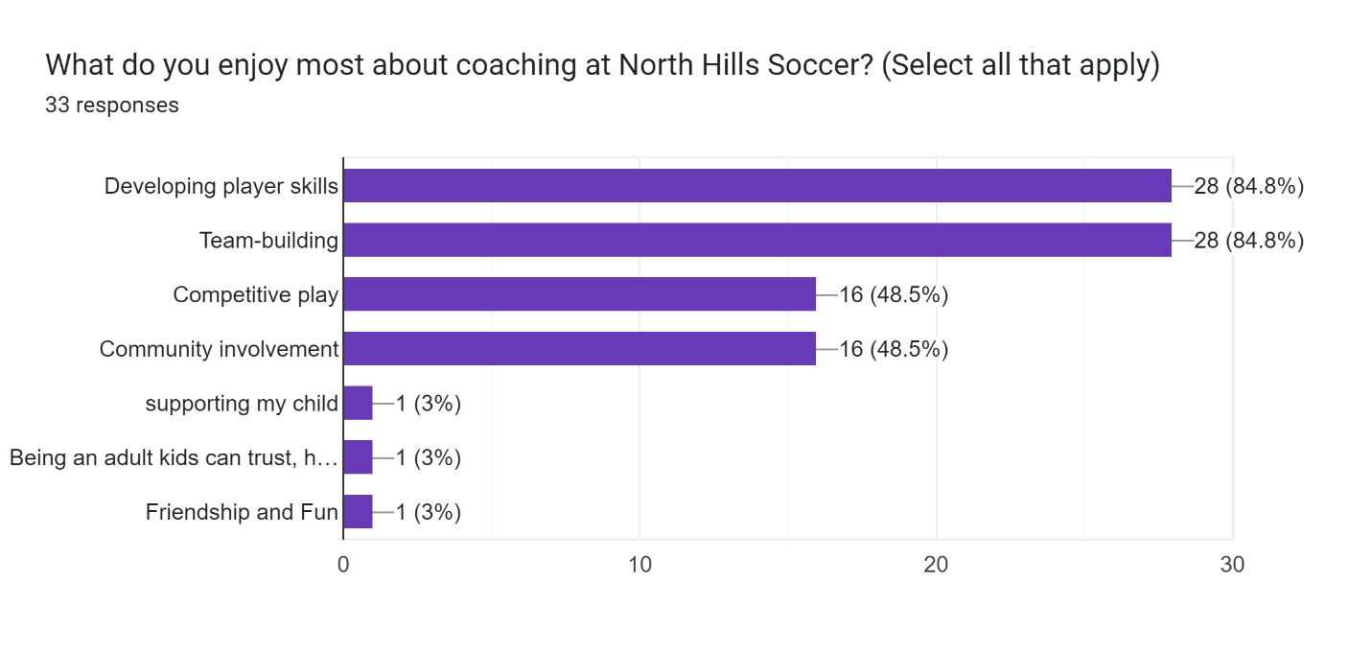

Slide 9
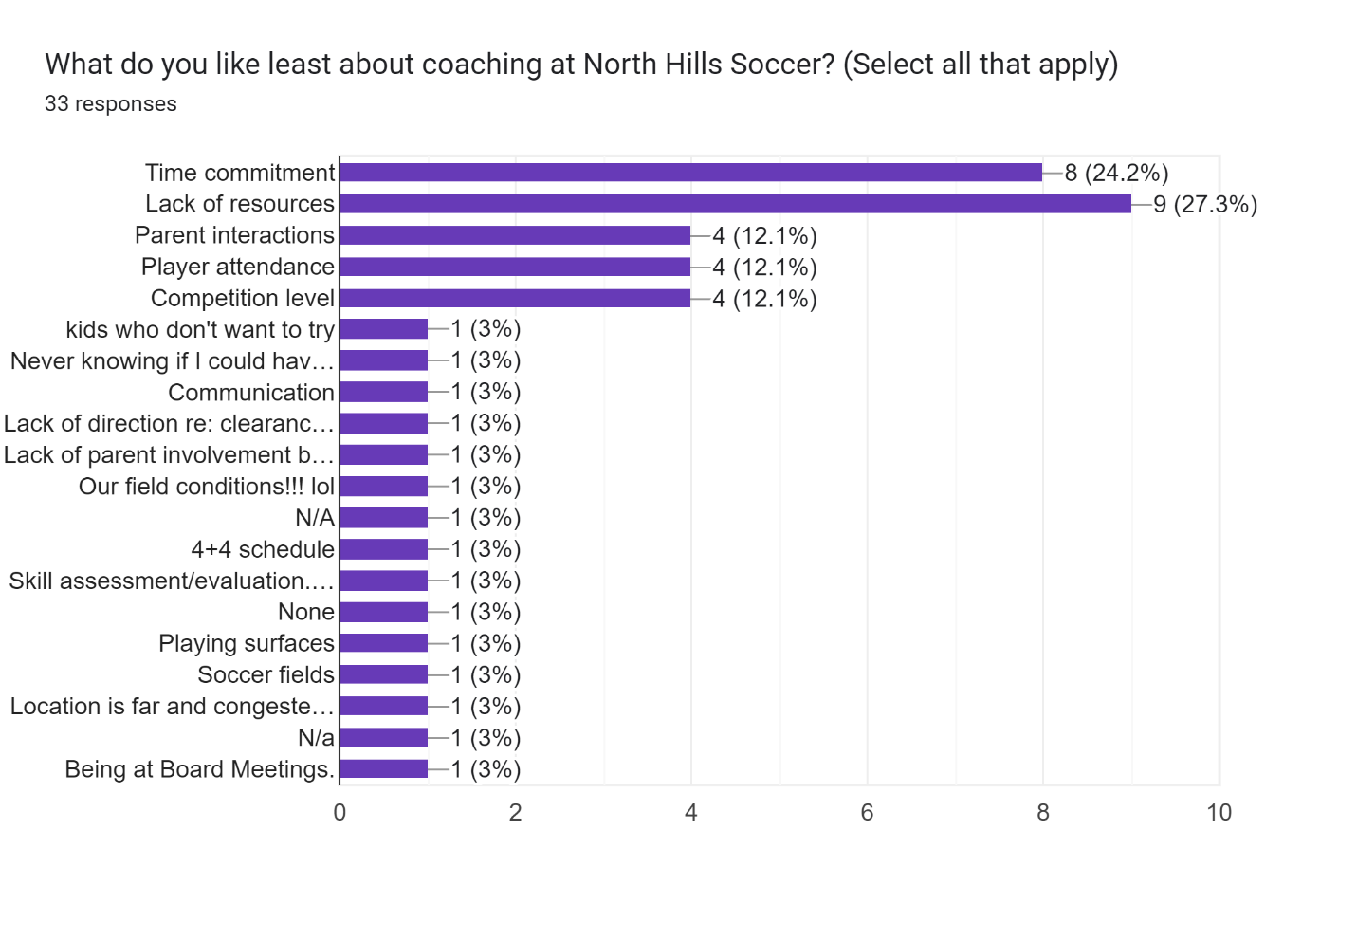

Slide 10
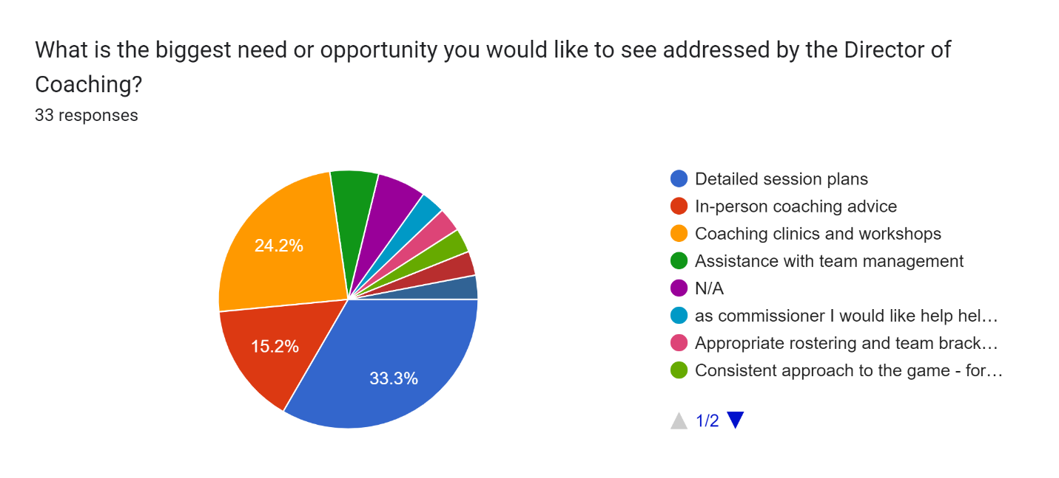

Slide 11
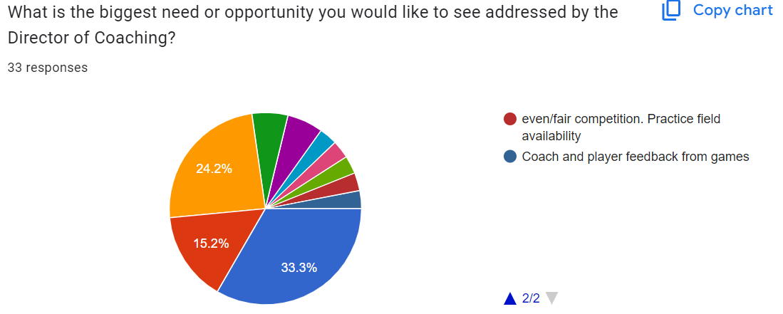

Slide 12
Timeline
December
Meet in-person with club commissioners
Send coach’s survey
January
Review coach’s survey results with the Commissioners and Board
February
Develop Coach Curriculum for U8 and U10
Meet with Jerry Concannon
March
Conduct U8 and U10 coach’s meeting with player demonstration
March 3rd at Highcliff?
Establish resource site for coaches – utilize current NHSC site to include coaching documents and demo videos.
Create Coach’s Team on Game Changer for DOC communication, best practice sharing and real-time Q/A.

Slide 13
Short Term Goals
Obtain feedback from Commissioners and Coaches
Commissioner in-person meeting to seek feedback
Coach Survey
Create enhanced U6 – U10 training curriculum and resources
Cascade and demonstrate at future in-person coach’s meetings
Validate it is consistently being followed
Start developing coaches at the U6 level

Slide 14
Long Term Goals
Enhance player evaluation and team placement process
What is the club’s philosophy?
Create Skills Competition End of season event opposite season of U8 Tournament for October/November 2025
U11-U14 Curriculum
North Hills Soccer Club and School District team/coaching alignment
Enhance district’s engagement with the club
Training curriculum and style of play alignment

